Slide 1
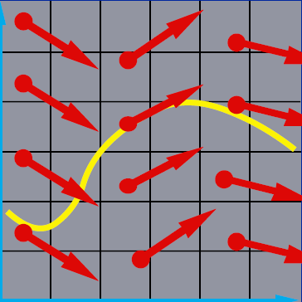
Numerical Solution of Ordinary Differentiation Equations
x₂
x₁

Slide 2
Numerical Methods for ODEs
Taylor Series
Euler’s method: one-term
Runge-Kutta method: higher-order terms
Multistep method
Implicit method

Slide 3
Runge-Kutta Method
Similar to the motivation of Taylor series method but do not require the computation of higher derivatives
Simulates the effect of higher derivatives by evaluating f several times between t_{n} and t_{n}+h

Slide 4
2nd Order Runge-Kutta Method
Uses a weighted average of slopes at t_{n} and a point obtained from computing a Euler step
Chooses parameters to make the solution agree as well as possible with the 2nd order Taylor series expansion:

Slide 5
Derivation of 2nd Order Runge-Kutta
Substitute to get a single expression
1
Evaluated with
Notes:
Note that the Taylor series expansion is 2-D, which is different from the earlier one used for deriving Euler’s method, where x is fixed, so we only need a 1-D expansion!

Slide 6
Derivation of 2nd Order Runge-Kutta
From the 2nd order Taylor expansion
2

Slide 7
Determining Parameter by Comparison
1
2
There are multiple sets of parameters that agree to the Taylor series expansion
1
=
2

Slide 8
2nd-order Runge-Kutta methods
a=0, b=1, α=β=1/2→midpoint method
a=b=1/2, α=β=1→modified Euler method
a=1/3, b=2/3, α=β=3/4→minimum bound

Slide 9
4th Order Runge-Kutta Method
Similarly, we can make the solution agree as well as possible with 4th-order Taylor series expansion
11 equation for 13 unknown parameters
Uses a weighted average of slopes obtained at four points

Slide 10
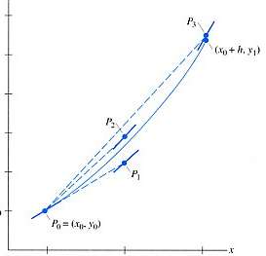
4th Order Runge-Kutta Method (cont.)
Using a weighted average of slopes obtained at four points

Slide 11
Example: Runge-Kutta Method
http://www.cs.illinois.edu/~heath/iem/ode/rungekut/

Slide 12
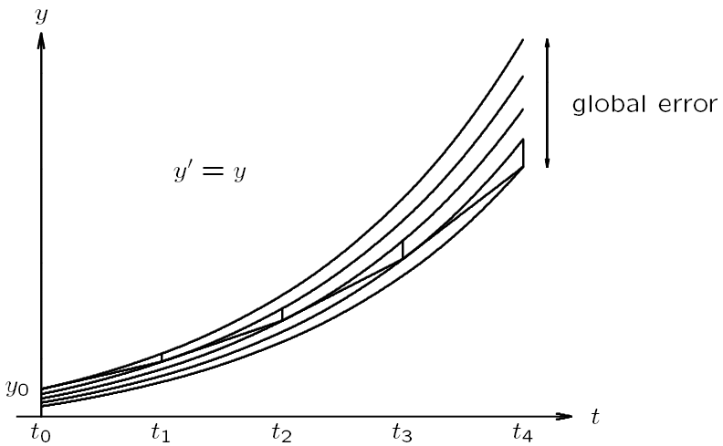
Local Error vs. Global Error
x
x’=x
local error
x₀
From Michael T. Heath

Slide 13
Local Error vs. Global Error
Local error: error made in one step of numerical method
where u_{n-1} is the member of the solution curves that passes through (x_{n-1},t_{n-1})
Global error: difference between computed solution and true solution determined by initial values at t₀

Slide 14
Step Size Selection
Take large steps to reduce computational cost, but also take into account both stability and accuracy
To yield a meaningful solution, step size must obey any stability restrictions
Local error estimate is needed to ensure that desired accuracy is achieved

Slide 15
Step Size Selection (cont.)
With Euler’s method, local error is approximately (h²/2)x”, so choose step size to satisfy
Other methods of obtaining error estimate are based on the difference between results obtained using methods of different orders or different step sizes

Slide 16
Runge-Kutta-Fehlberg method
4th order Runge-Kutta is very popular for its simplicity and good accuracy
Classical Runge-Kutta methods provide no error estimate
We need an error estimate to adjust the step size→ Runge-Kutta-Fehlberg method

Slide 17
Runge-Kutta-Fehlberg method (cont.)
Uses 6 function evaluations per step to produce both fifth-order and fourth-order estimate of solution
The difference of these two estimates provides an error estimate for the computed solution
Adjust h based on the value of estimated error
This is implemented in Matlab as ode45
ode23 is also provided

Slide 18
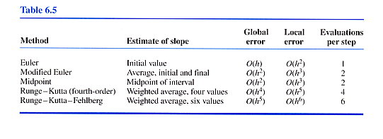
Summary

